Slide 1
RAJALAKSHMI ENGINEERING COLLEGE
Department of Computer Science Engineering
GE19611-PROFESSIONAL READINESS FOR INNOVATION,
EMPLOYABILITY AND ENTREPRENEURSHIP.

Slide 2
HEIGHT BASED PARKING ALLOCATION SYSTEM - CARS(HPSC) USING INFRARED OBSTACLE DETECTOR
DR.MR.P.SHANMUGAM M.Tech., Ph.D
ASSISTANT PROFESSOR
PROJECT BY:
SUGANYA S(210701270)
DAVID KINGSLI D(210701523)
SYLVIA V(210701279)

Slide 3
PROBLEM STATEMENT
Inefficient utilization of parking space for small vehicles in urban areas leads to congestion, reduced parking capacity, and a poor parking experience for drivers. Traditional parking systems often allocate static parking spaces that do not cater to the varying sizes of vehicles, resulting in wasted space and increased difficulty in finding suitable parking spots. This inefficiency not only impacts urban mobility but also contributes to increased emissions and fuel consumption as drivers spend more time searching for parking. There is a critical need for innovative solutions to optimize parking space for small vehicles, enhance accessibility,and promote sustainable urban transportation practices.

Slide 4
AGENDA
01.
Objectives
03.
Results
02.
Methodology
04.
Conclusions
You can describe the topic of the section here
You can describe the topic of the section here
You can describe the topic of the section here
You can describe the topic of the section here

Slide 5
ABSTRACT
An innovative IOT based project designed to revolutionize car parking by dynamically sensing and allocating parking space. A dynamic parking management system leveraging IoT and vehicle height recognition. Through sensors and advanced technologies the system optimizes space allocation, reducing congestion and environmental impact by minimizing unnecessary vehicle circulation. Real-time updates enhanced user experience. It addresses the shortcomings of current static parking systems, offering a sustainable and scalable solution for urban areas. Experimental evaluations confirm its effectiveness, showcasing its potential to revolutionize urban parking management by monitoring parking slots and improving overall space utilization.

Slide 6
OBJECTIVES
1. To enhance parking efficiency by accurately detecting vehicle height for optimal space allocation.
2. To improve safety by preventing over-height vehicles from entering restricted areas.
3. To automate parking management using IR sensors to reduce labor costs and errors.
4. To provide real-time monitoring and alerts for non-compliant vehicle heights.
5.To design a user-friendly interface to guide drivers to suitable parking spots based on vehicle height.

Slide 7
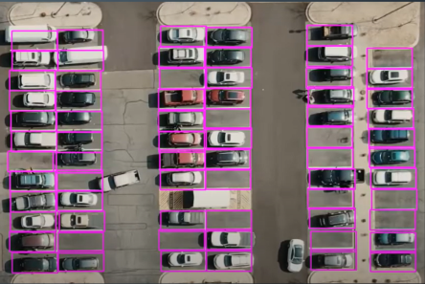
EXISTING SYSTEM
Uses open CV algorithm
Suitable for open area parking
Not efficient
No proper space allocation
Takes more time for image processing.
Not suitable for indoor parking area especially basement parking.
Takes more time to park in means of searching the parking slot.

Slide 8
PROPOSED SYSTEM
The proposed parking system focuses on efficiently using space by organizing parking across multiple levels. It uses sensors like ultrasonic and infrared to measure vehicle height and detect obstacles. Ultrasonic sensors emit sound waves to measure height, while infrared sensors detect obstacles to guide vehicles into parking spaces without collisions. A cloud-connected database communicates with a serial interface module, updating real-time parking availability. This information is displayed on monitors throughout the parking facility, directing drivers to available spots.This system maximizes parking space by considering vehicle height and enhances the parking experience. It reduces congestion, cuts down on time spent searching for parking, and ensures a smoother process with the help of specific components like Espressif System, HC-SR04 Ultrasonic Sensor, infrared obstacle detector sensor, and TowerPro Micro Servo Motor SG90.

Slide 9
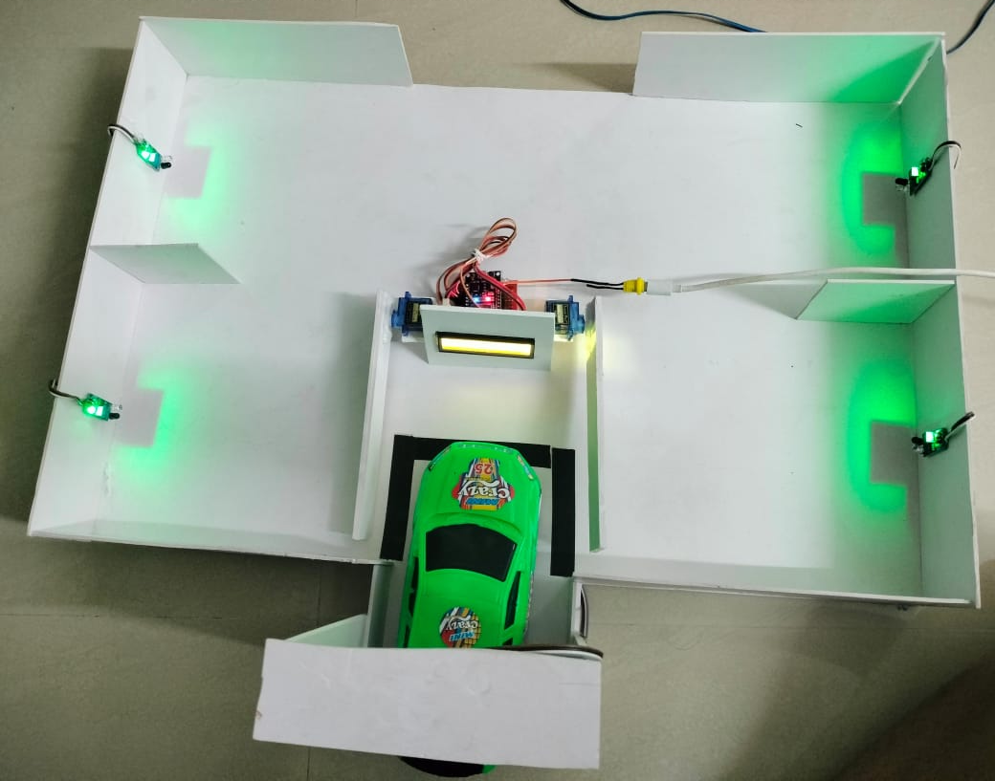
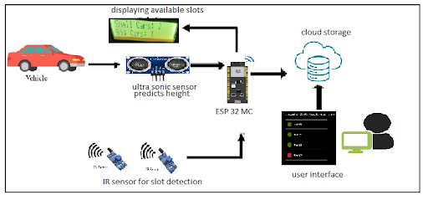
ARCHITECTURE DIAGRAM

Slide 10
REQUIREMENTS
SOFTWARE
HARDWARE
Adafruit.io
I2C Serial interface 1602
ESP32 -Wifi /Bluetooth
HC -SR04 Ultra Sonic Sensor
InfraRed Obstacle detector
TowerPro Micro Servo Motor

Slide 11
MODULE
I2C Serial interface 1602
ESP32 -Wifi /Bluetooth
HC -SR04 Ultra Sonic Sensor
InfraRed Obstacle detector
TowerPro Micro Servo Motor

Slide 12
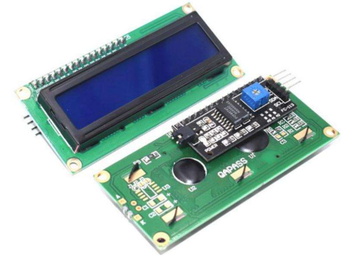
I2C Serial interface 1602
This I2C interface 16x2 LCD display module is a high-quality two-line, sixteen-character LCD module with inside contrast control adjustment, backlight, and an I2C interactions interface. For Arduino beginners, there is no longer a need for an advanced LCD driver circuit connection. The real significant advantages of this 12C Serial LCD module include reducing the circuit connection, save some 10 pins on the Arduino board, and simplified firmware development with the widely available Arduino library .

Slide 13
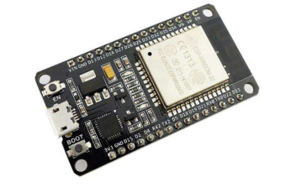
ESP32 -Wifi /Bluetooth
ESP32 is a low-cost and low-power consumption system.It comes with WiFi and dual-mode Bluetooth. Through that, the power is connected to the system through the C-type cable. The module is connected to the monitoring display and the cloud.

Slide 14
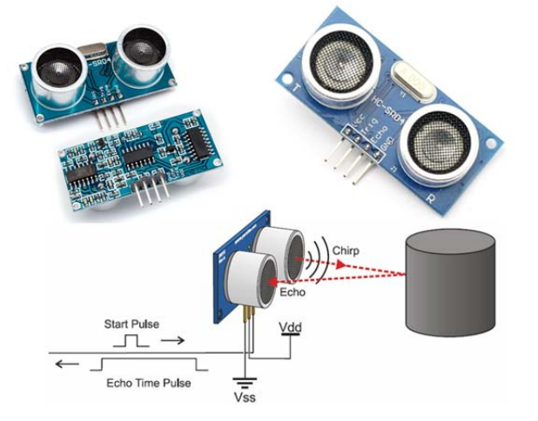
HC -SR04 Ultra Sonic Sensor
The HC-SR04 Ultrasonic(US) Sensor is a very affordable proximity/distance sensor that is mainly used for sensing, echolocating, and even as a parking sensor.The picture depicts the view of US sensor. When a car enters the parking area, the US senses the height of the car. Based on the height, the multi-level area is allocating the parking space.Once the parking is done, it reflects with the help of an IR obstacle detector and is notified in the cloud.

Slide 15
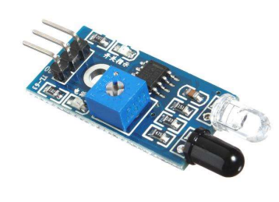
InfraRed Obstacle detector
The infrared sensor (IR), which is focusing to detect the presence of car in the parking area.It is primarily attached to one light, and once the vehicle is parked, it notifies with two lights. It detects within the range of 2 to 20 cm, but it also has the potential to change the distance of detection as per human needs.

Slide 16
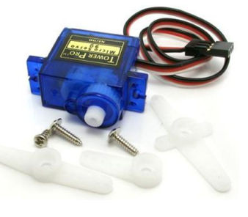
TowerPro Micro Servo Motor
Tiny and lightweight, with a high output power. Servos can rotate approximately 180 degrees (90 in each direction) and function similarly to standard servos but are smaller in size. These servos can be controlled using any servo code, hardware, or library. It's ideal for beginners who want to make things move without having to build a motor controller with feedback and a gearbox, especially because it can fit in small spaces. It comes with three arms and hardware.

Slide 17

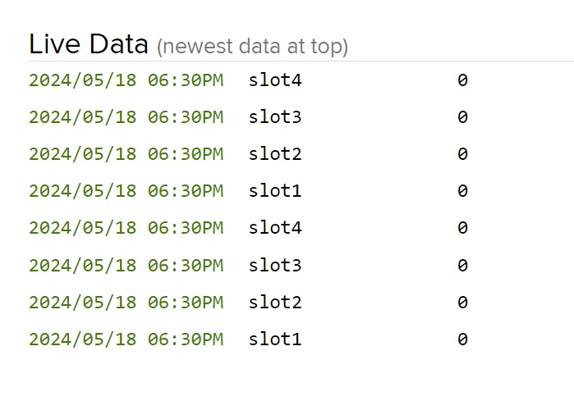
Results and Discussion
Slot availability in the parking system
Intime data records of car when entering into parking area.

Slide 18
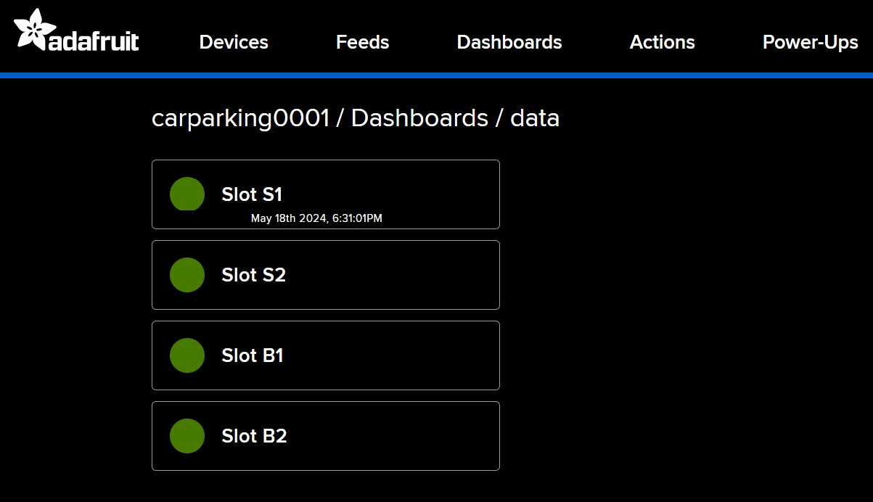
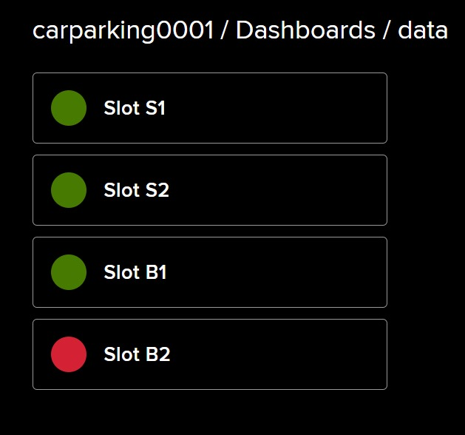
Results and Discussion
Slot status before parking in the cloud data.
GREEN- indicates the available slots.
RED- indicates the car parked slots.
This is viewed through cloud.

Slide 19
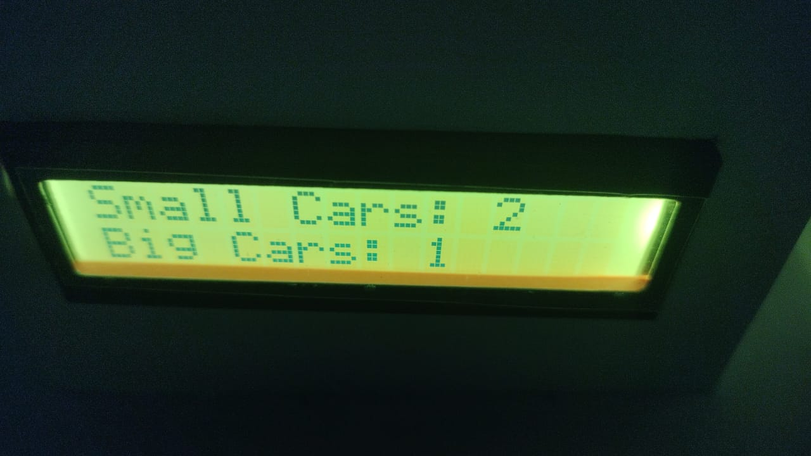
Results and Discussion
By classifying vehicles based on height, the height-based car parking system maximizes available space by increasing capacity by 20–30%. With the help of this system, parking searches take 15% less time, and congestion reduces, resulting in improved traffic flow and lower emissions. Easy navigation and a 10% decrease in parking-related accidents led to a 25% increase in user satisfaction.The system improves overall efficiency and safety in spite of these costs. The system's benefits and shortcomings are emphasized by comparative studies and user input. The height-based parking system provides a creative fix.
Slot availability displaying through I2C.

Slide 20
CONCLUSION
Current obstacle detection technology in height-based parking systems has significantly improved the efficiency, security, and user experience of parking facilities. A smart parking environment that effectively manages space utilization and provides users with seamless services can be created by combining advanced sensor technology, real-time data connectivity, artificial intelligence and machine learning, and user-friendly interfaces. The combination of IoT and cloud computing ensures the longevity and dependability of the system and allows for real-time monitoring and predictive maintenance. Improved safety features and security measures protect users as well as the infrastructure, while environmentally friendly and energy-efficient technologies align the system with sustainable practices.Because these parking options can be tailored to match various facility layouts and sizes, they are easy and flexible.

Slide 21
FUTURE ENHANCEMENT
The future enhancements include fare calculation and extended parking with compensating the parking areas.Using the historical data to analytically approach peak hours.A modular approach to expanding the parking area during insufficient parking slots. Enhance separate parking slots for Ev cars along with a charging system and develop a mobile application to book the parking slot to make a reservation system.Upgrade to a 3D LIDAR or radar sensor instead of an ultrasonic sensor to get more accurate detection within seconds.

Slide 22
REFERENCE
Dixit, Madhur, et al. "Smart parking with computer vision and IoT technology." 2020 43rd International Conference on Telecommunications and Signal Processing (TSP). IEEE, 2020.
Abd Kadir, Muhamad Muzhafar, et al. "IoT based car parking management system using IR sensor." Journal of Computing Research and Innovation 5.2 (2020): 75-84.
Shankar, S. Siva, et al. "IoT-based parking surveillance scheme: Emerging a smart, effective, and secured solution for urban parking management and performance improvement." MATEC Web of Conferences. Vol. 392. EDP Sciences, 2024.
Wang, Ange, and Zhengtao Qin. "Development of an IoT-Based Parking Space Management System Design." International Journal for Applied Information Management 3.2 (2023): 91-100.
Sudhakar, M. V., Reddy, A. A., Mounika, K., Kumar, M. S., & Bharani, T. (2023). Development of smart parking management system. Materials Today: Proceedings, 80, 2794-2798.

